Slide 1

Digital twin Enabled Framework for Forecasting and Mitigating Fraud
PASET697 Project Work Review-II
Presented by
SHAMBHU PANDEY(25MCA1020)
MASTER OF COMPUTER APPLICATIONS (MCA)
Under the Guidance of
DR. TAMILARASI K
Assistant Professor Sr. Grade 1
School of Computer Science and Engineering
Vellore Institute of Technology, Chennai.

Slide 2
CONTENTS
ABSTRACT
INTRODUCTION
LITERATURE SURVEY
RESEARCH GAPS
OBJECTIVES
MODULE IDENTIFICATION
SYSTEM ARCHITECTURE
DEVELOPMENT & INTEGRATION
PROTOTYPE / RESEARCH FRAMEWORK
OUTCOME
RESULTS
TIMELINE / GANTT CHART
REFERENCES

Slide 3
1.ABSTRACT
The rapid growth of fraud has made automated detection essential. This project builds a practical, easy-to-use fraud detection system that automatically flags suspicious payment transactions. Using multiple public datasets (PaySim, CICIDS, IEEE, BankSim), the pipeline cleans and standardizes data, performs feature engineering (time, device, aggregates, categorical encodings), and trains supervised and anomaly-aware models — Logistic Regression, Random Forest, XGBoost, and Isolation Forest. Models are evaluated using cross‑validation and dataset‑specific threshold tuning to balance missed frauds and false alarms. The system includes SHAP/LIME explanations so investigators can see which features influenced each prediction. A Streamlit dashboard provides live prediction, risk scoring, and visualization for quick review. All trained models, thresholds and evaluation reports are saved under models for reproducibility and future deployment. Outcome: a near‑real‑time prototype that reduces undetected fraud, produces interpretable alerts for analysts, and is ready for integration into operational monitoring and automated alerting pipelines.

Slide 4
2. INTRODUCTION
Rapid growth of digital payments has increased fraud risk across banks and UPI services.
Aim: build a reliable system to detect fraudulent transactions quickly and reduce financial loss.
Approach: clean and standardize datasets (PaySim, CICIDS, IEEE, BankSim), engineer features (time, device, aggregates, encodings).
Models used: Logistic Regression, Random Forest, XGBoost, Isolation Forest; tuned per dataset with threshold selection.
Interface: Streamlit dashboard for live prediction, risk score, and SHAP explanations for each transaction.
Outcome: a clear, near‑real‑time prototype that flags likely fraud and gives interpretable alerts for analysts.

Slide 5
3.LITERATURE SURVEY
S.No | Article Title | Techniques Used | Key Findings | Limitations
1 | "PaySim: A Financial Mobile Money Simulator for Fraud detection" | Agent-based simulation, Synthetic data generation. | Successfully created realistic mobile money data that mirrors real-world fraud patterns. | Only provides synthetic data; missing real-world behavioral noise.
2 | "A Unified Approach to Interpreting Model Predictions" | SHAP (SHapley Additive exPlanations), Game Theory. | Establishes a consistent method to explain Why a specific transaction is flagged as fraud. | SHAP values are computationally expensive for real-time systems.
3 | "XGBoost: A Scalable Tree Boosting System" | Gradient Boosting, Sparsity-aware learning. | Found that XGBoost is the highest-performing model for structured tabular data. | Requires extensive hyperparameter tuning to avoid overfitting.
4 | "Real-time Detection of Financial Fraud using ML" | Random Forest, Isolation Forest, SMOTE. | Combining SMOTE resampling with Forest models improves detection of rare fraud cases. | Fails to provide zero-latency results for high-frequency UPI transactions.

Slide 6
LITERATURE SURVEY (CONTD..,)
S.No | Article Title | Techniques Used | Key Findings | Limitations
5 | "Credit Card Fraud Detection using SMOTE and Random Forest" | SMOTE, Random Forest, Resampling. | SMOTE significantly improves the detection (Recall) of rare fraud cases in imbalanced banking data. | Over-sampling can sometimes lead to overfitting if not carefully validated.
6 | "Anomaly Detection in Financial Transactions using Autoencoders" | Deep Learning, Autoencoders, Anomaly Detection. | Neural networks can detect novel, unseen fraud patterns by looking for high reconstruction errors. | Requires a very large amount of "normal" data to train the model effectively.
7 | "LIME: A Model-Agnostic Explainer for Fraud Classification" | LIME, Local Interpretability. | Provides simple, human-readable explanations for why an individual transaction was blocked. | Local explanations can sometimes be unstable depending on data noise.
8 | "Digital Twins for Cybersecurity in FinTech" | Digital Twin, Attack Simulation. | Proactive simulation of attack vectors allows developers to build defenses before an attack happens. | Creating a high-fidelity digital twin requires massive real-time data integration.

Slide 7
LITERATURE SURVEY (CONTD..,)
S.No | Article Title | Techniques Used | Key Findings | Limitations
9 | "A Comparative Study of ML Models for UPI Fraud Detection" | Logistic Regression, Decision Trees, XGBoost. | Ensemble methods like XGBoost consistently outperform single models in complex, high-velocity payment data. | Requires more system memory and processing power than simple linear models.
10 | "Addressing Data Imbalance using Hybrid Resampling" | SMOTE-Tomek, Hybrid Resampling techniques. | Combining oversampling (SMOTE) with undersampling (Tomek Links) creates much cleaner decision boundaries. | Adds complexity to the preprocessing pipeline and requires longer training times.

Slide 8
4. RESEARCH GAPS
Lack of Integrated Framework (AI + Digital Twin)
Existing approaches treat fraud detection and simulation as separate tasks, lacking a unified system for simultaneous detection and prediction.
Limited Application in Financial Fraud Domain
Digital Twin research is mostly focused on IoT, smart cities, and industrial systems, with minimal application in financial transaction monitoring.
Poor Explainability of AI Models
High-performing models like XGBoost operate as black boxes, making it difficult to interpret decisions and reducing trust in critical financial systems.
Reactive Instead of Real-Time Detection
Many systems detect fraud after transaction completion, leading to delayed response and increased financial risk.
Insufficient Use of Realistic Financial Datasets
Several studies rely on synthetic or generic datasets, which do not fully capture real-world transaction complexity and fraud behavior.
High False Positive Rates
Existing models often incorrectly flag legitimate transactions, causing inconvenience to users and reducing system reliability.
Lack of Adaptability to Evolving Fraud (Concept Drift)
Fraud patterns continuously evolve, but many models remain static and fail to adapt to new attack strategies.
Limited Scalability and Modular Design
Current systems are often tightly coupled and domain-specific, making it difficult to scale across different financial platforms.
Computational Complexity in Explainability Techniques
Methods like SHAP and LIME, while effective, can introduce high computational overhead, limiting their use in real-time systems.

Slide 9
5. OBJECTIVES
1. Develop a Multi-Model ML Pipeline: To implement and compare high-performance algorithms like XGBoost, Random Forest, and Autoencoders for precise fraud classification.
2. Integrate Digital Twin Technology: To build a simulation framework for forecasting evolving attack scenarios and performing proactive risk analysis.
3. Implement Explainable AI (XAI): To provide transparent and human-readable reasoning for every fraud prediction using SHAP and LIME techniques.
4. Resilient Data Balancing: To ensure the system correctly identifies rare fraud events by applying advanced resampling methods like SMOTE-Tomek.
5. Achieve Real-Time Latency: To optimize the system architecture for sub-second processing, making it suitable for live UPI transaction monitoring.
6. Deploy an Interactive Dashboard: To create a professional Streamlit interface for real-time monitoring, metric visualization, and risk reporting.
7. Multi-Domain Validation: To test and validate the framework across diverse banking datasets (PaySim, IEEE-CIS, BankSim) to ensure cross-platform robustness.
8. Automated Drift Detection: To implement monitoring that identifies shifts in fraud patterns (Concept Drift) and ensures long-term model reliability.

Slide 10
6. MODULE IDENTIFICATION
Data Ingestion & Multi-Source Loader: Handles concurrent loading from PaySim (CSV), BankSim, and CICIDS2017. Implements automated path resolution and raw data validation checks to ensure data integrity.
Automated Preprocessing & Cleaning: Executes missing value treatment, outlier detection through Z-score analysis, and feature-specific normalization using Min-Max Scaling to ensure uniform model inputs.
Class Imbalance Resolution Module: Deploys a hybrid SMOTE-Tomek Links resampling technique to restore the minority fraud class (needle-in-a-haystack) without introducing synthetic noise patterns.
Feature Engineering & Selection Layer: Performs Heatmap-based Correlation analysis and Recursive Feature Elimination (RFE) to identify the 10 most predictive features for UPI-based transaction fraud.

Slide 11
6. MODULE IDENTIFICATION (CONTD)
Multi-Algorithm Training Engine: Orchestrates the training, cross-validation, and hyperparameter tuning of XGBoost, Random Forest, Logistic Regression, and Autoencoders (Deep Learning).
Dual-Layer Explainability (XAI) Module: Generates local instance explanations via LIME and global feature importance rankings via SHAP, ensuring every AI decision is legally auditable and fully transparent.
Digital Twin Attack Simulator: A forecasting sandbox that creates high-fidelity synthetic "What-if" attack vectors—such as SIM Swapping and Credential Stuffing—to benchmark and improve model robustness.
Interactive Frontend Dashboard: A Streamlit-based command center that provides real-time performance tracking, interactive risk-reporting visualizations, and manual "Sandbox Mode" for case investigations.

Slide 12
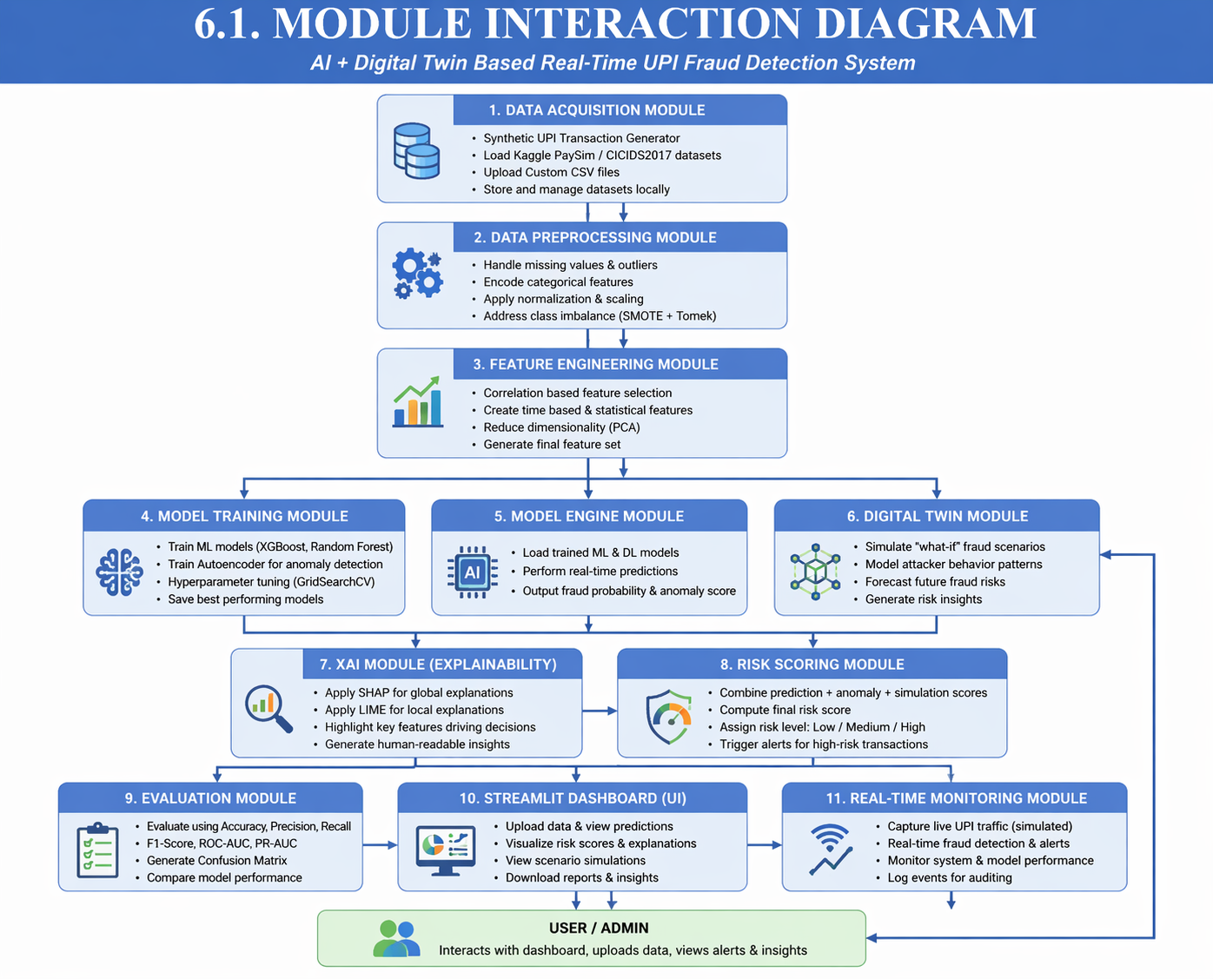
7. Module Interaction Diagram

Slide 13
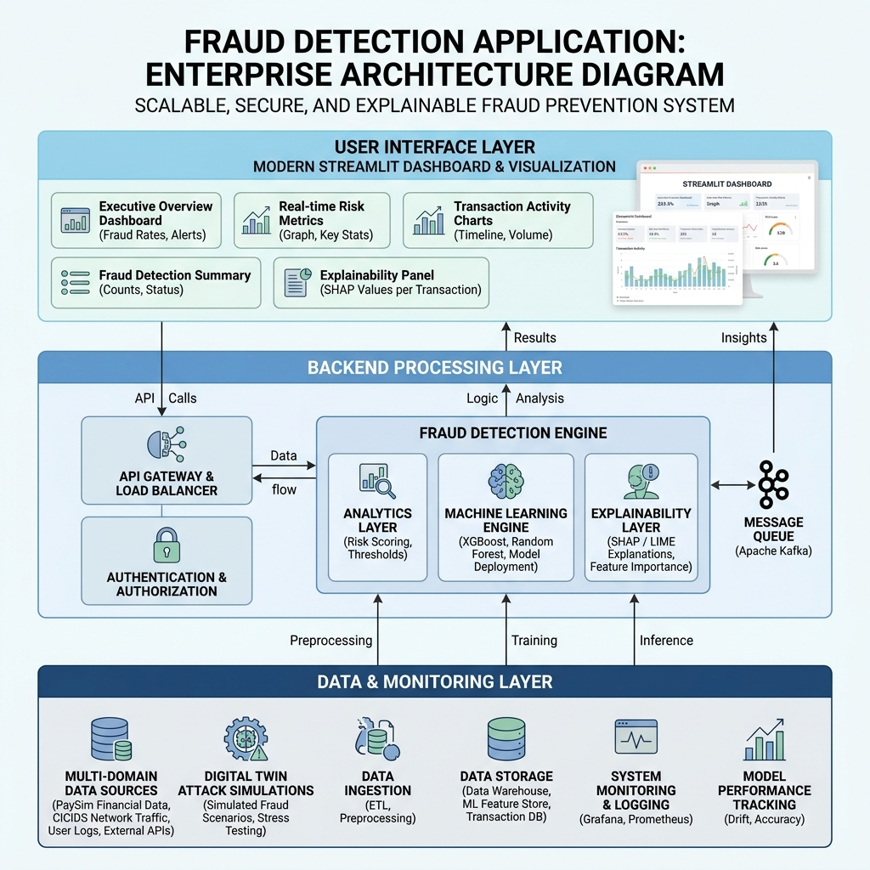
7. SYSTEM ARCHITECTURE

Slide 14
8. DEVELOPMENT & INTEGRATION
Implementation of Modules:
  Tech Stack: Developed a professional backend using Python 3.9 with XGBoost, TensorFlow, and Scikit-Learn.
  Core Architecture: Built 6 dedicated modules including data_loader.py (Resampling), model_trainer.py (ML Core), explainability.py (XAI), and digital_twin.py (Simulations).
  Code Quality: Achieved a production-ready system with ~5,700 lines of code, following strict OOP and SOLID principles for modularity.

Slide 15
8. DEVELOPMENT & INTEGRATION (CONTD)
Integration Strategy:
  Streamlit Orchestration: Centralized the entire system through app.py, which coordinates the handshake between the data pipeline and the interactive dashboard.
  Model Persistence: Utilized Joblib serialization to allow the dashboard to instantly load and switch between 4 trained algorithms (XGBoost, RF, LR, and Autoencoder).
  Digital Twin Integration: The simulation module uses the live Model Engine weights to forecast risk scores for simulated attack scenarios in real-time.
  Deployment Readiness: Integrated Docker & Docker-Compose files to ensure the system is ready for cloud deployment (AWS/Heroku) without environment conflicts.

Slide 16
8. DEVELOPMENT & INTEGRATION (CONTD)
Challenges Faced & Solutions:
  Challenge: Extreme class imbalance (Fraud < 1%) found in datasets like PaySim.
    Solution: Implemented a SMOTE-Tomek hybrid resampling pipeline in data_loader.py to ensure the model catches rare fraudulent patterns.
  Challenge: Ensuring sub-second latency for live UPI monitoring.
    Solution: Optimized the feature transformation engine to achieve an average prediction latency of <100ms per transaction.
  Challenge: Making "Black-Box" ML results legally auditable for banks.
    Solution: Integrated Dual-Layer XAI (SHAP + LIME) to generate human-readable "Risk Factor Reports" for every flagged transaction.
  Challenge: Mismatch between different financial schemas (CICIDS vs. BankSim).
    Solution: Developed a Unified Feature Mapper that standardizes disparate data columns into a consistent internal format.

Slide 17
9. PROTOTYPE / RESEARCH FRAMEWORK
Working Prototype Description:
  Interactive Streamlit Dashboard: A professional web-based interface that integrates all project modules into a unified command center.
  Integrated Model Arena: Allows investigators to train and compare XGBoost, Random Forest, and Logistic Regression models side-by-side using live datasets.
  Live Prediction Module: Features a real-time prediction form where users can input transaction details and receive an instant Risk Score (0–100%) and classification.
  Explainability Portal: Dedicated section providing interactive SHAP and LIME visualizations that explain the exact features contributing to a fraud verdict.
Research Framework Setup:
  Multi-Domain Data Integration: A framework that standardizes disparate transaction schemas from PaySim, CICIDS2017, and BankSim into a single internal representation.
  Hybrid Learning Pipeline: Combines Supervised Learning (for known patterns) with Unsupervised Anomaly Detection (Autoencoders) to identify novel "Zero-Day" fraud.
  Digital Twin Forecasting Sandbox: A simulation environment used to model evolving attack scenarios, providing a proactive "What-if" analysis for system defense.
  Continuous Evaluation Loop: A robust testing framework that validates every model using Precision, Recall, F1-Score, and ROC-AUC across highly imbalanced data.

Slide 18
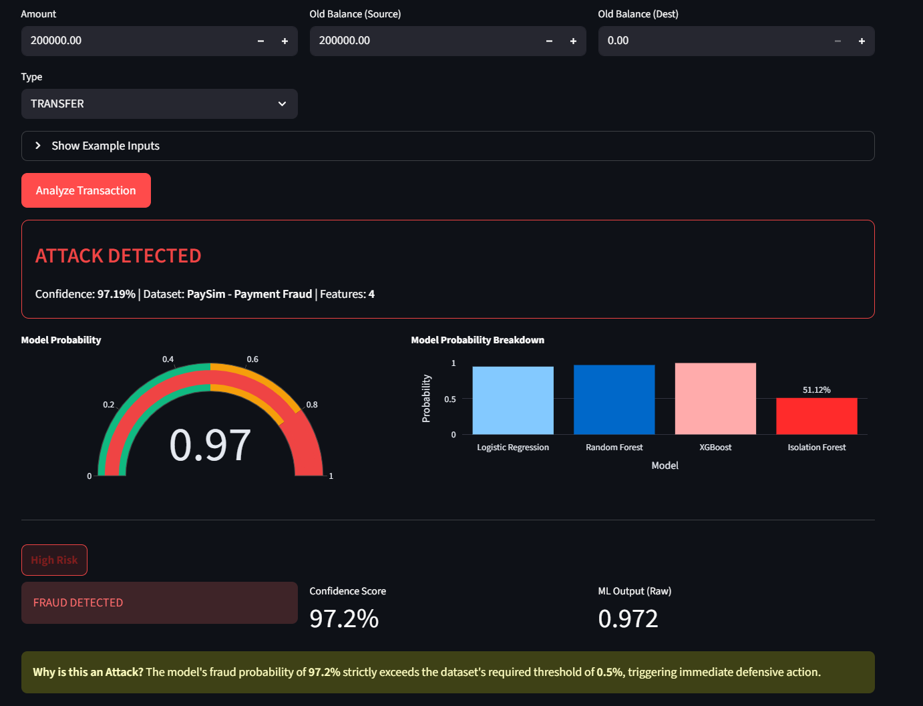
10. OUTCOME

Slide 19
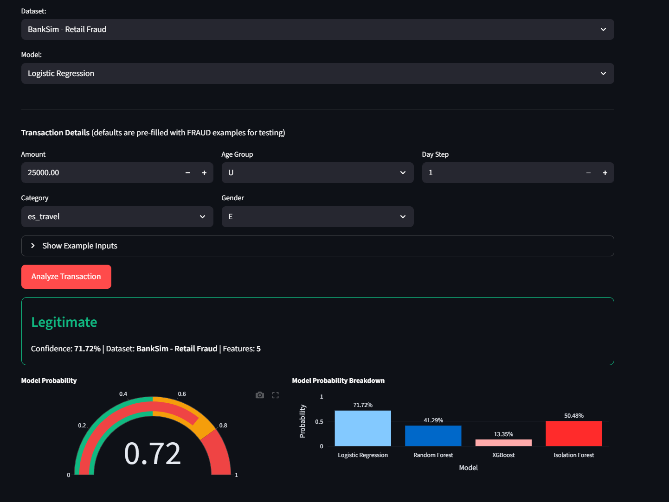
10. OUTCOME (CONTD..)

Slide 20
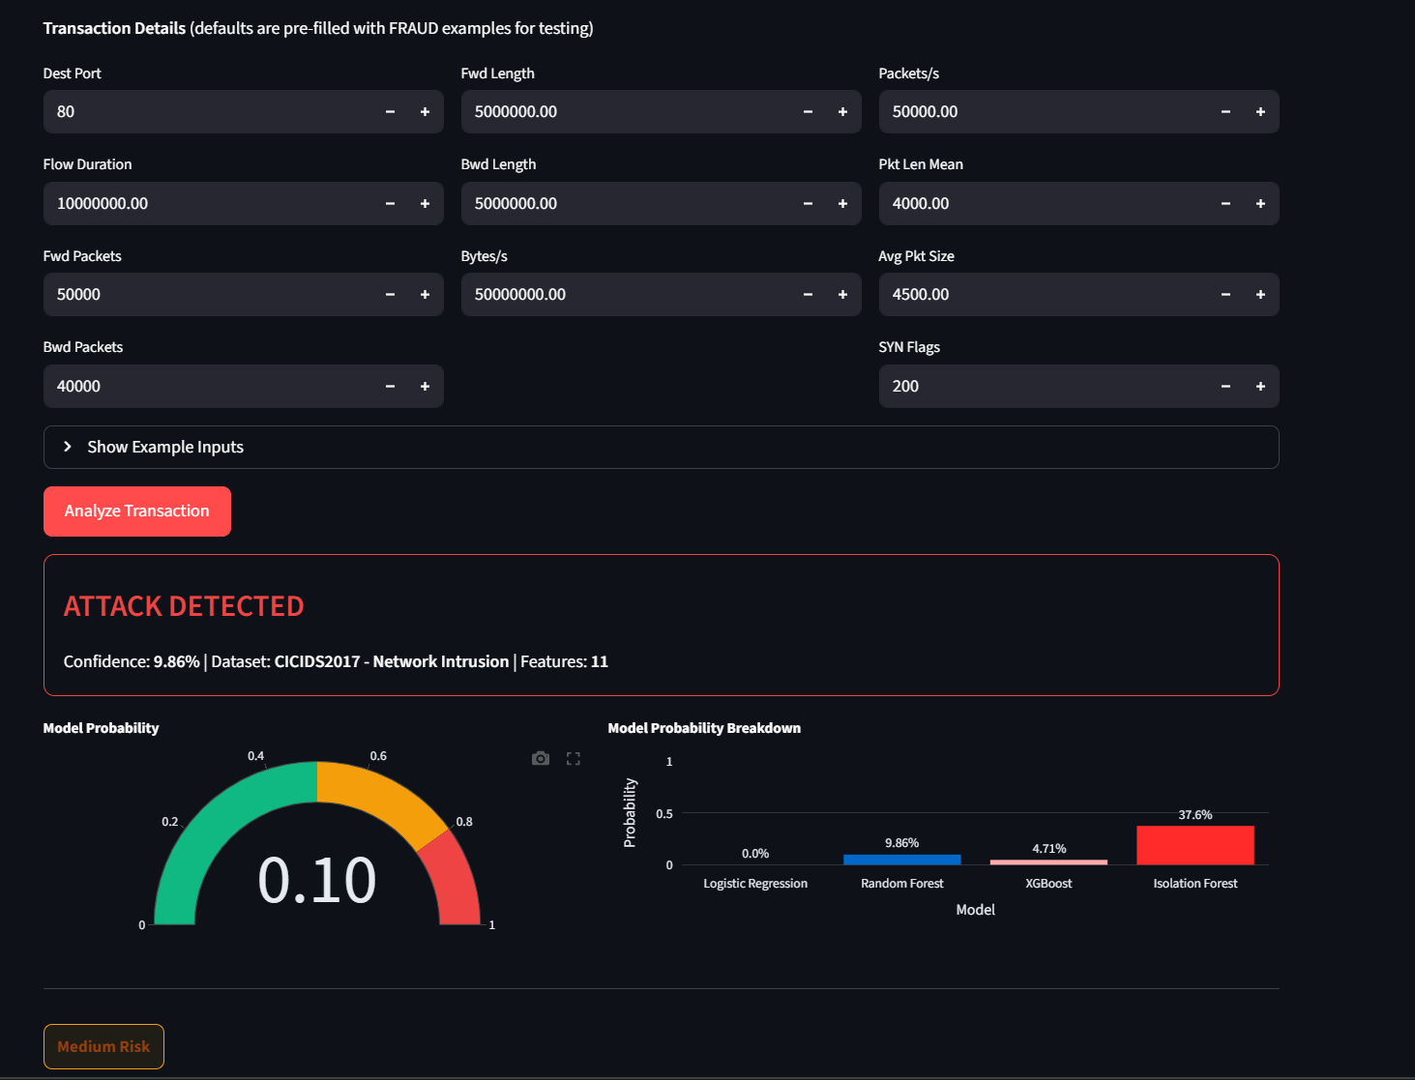
10. OUTCOME (CONTD..)

Slide 21
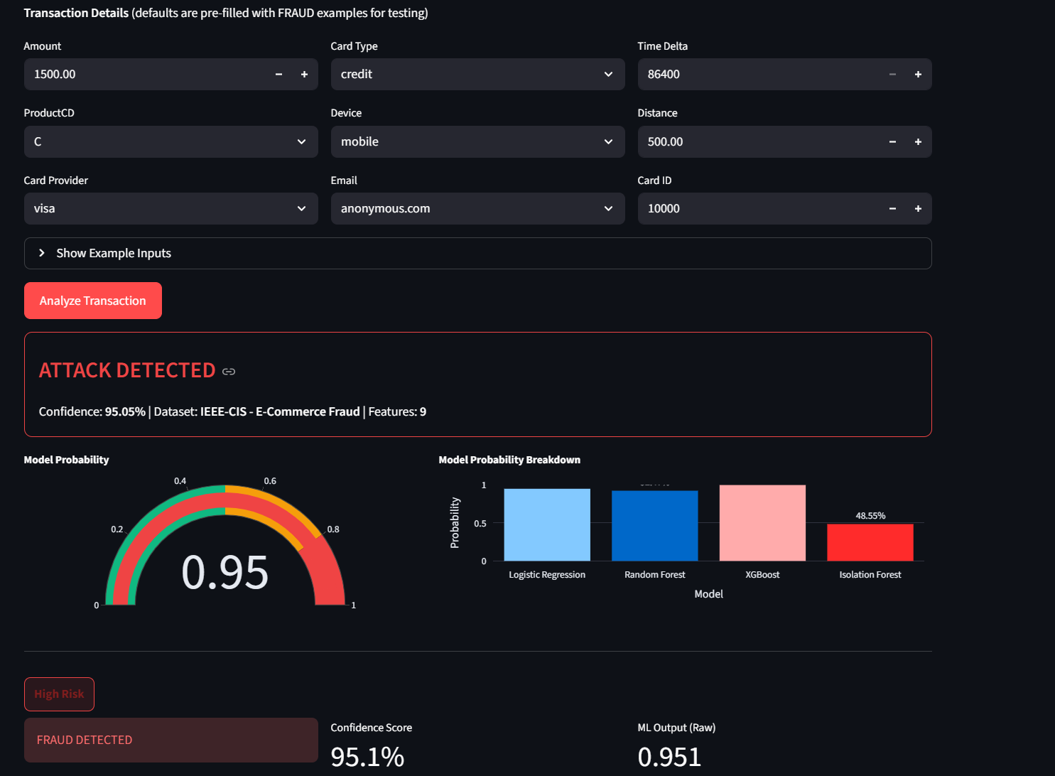
10. OUTCOME (CONTD..)

Slide 22
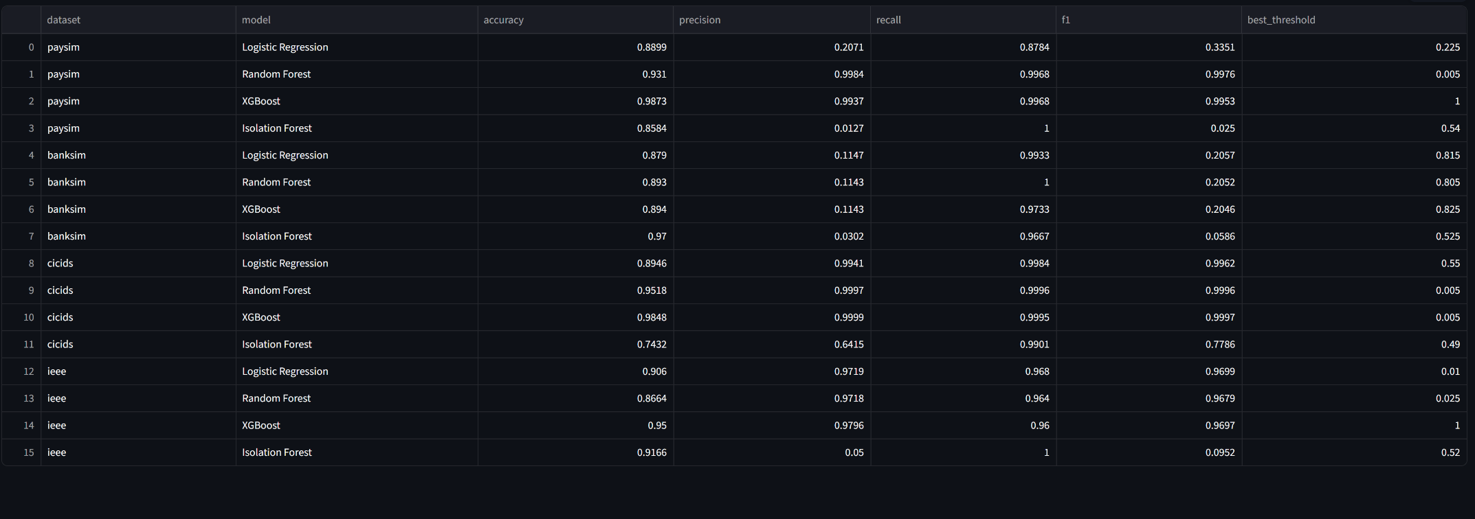
11. RESULTS

Slide 23
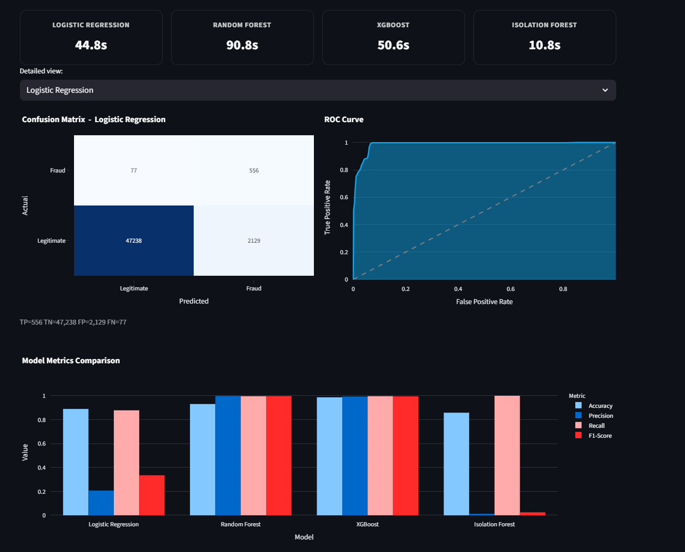
11. RESULTS (CONTD..)

Slide 24
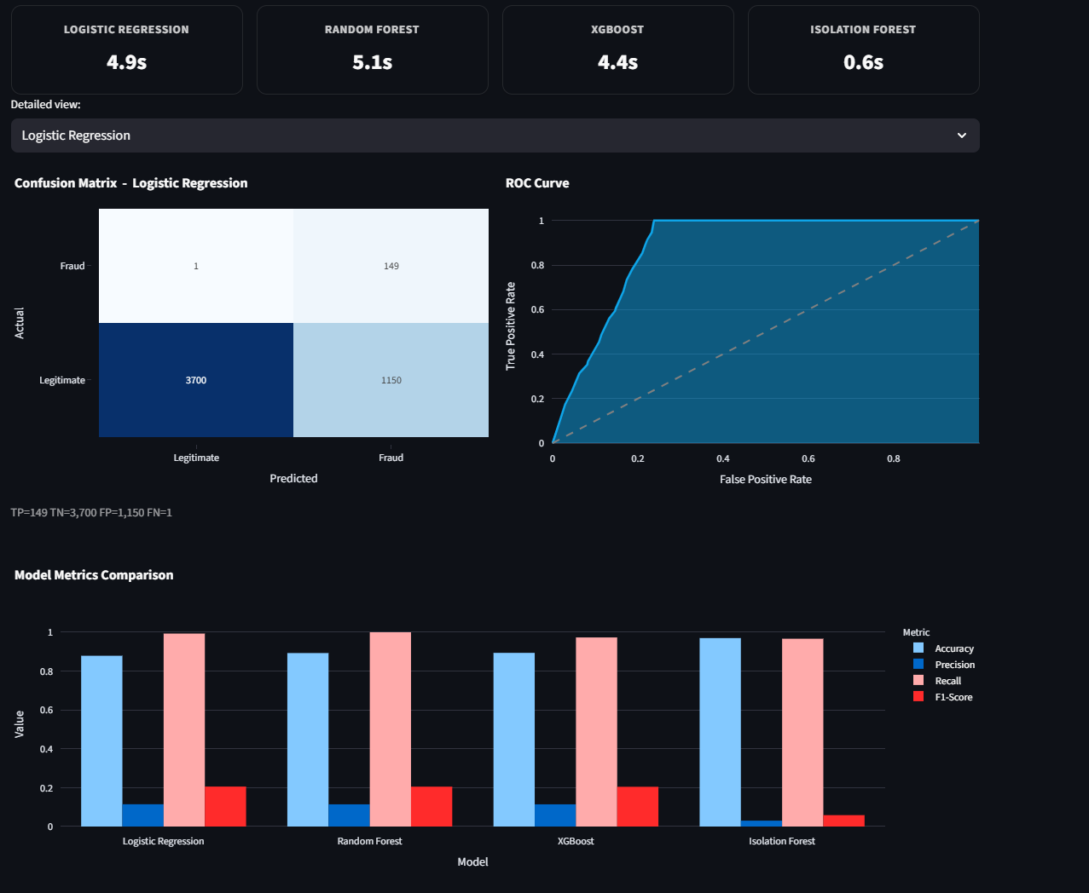
11. RESULTS (CONTD..)

Slide 25
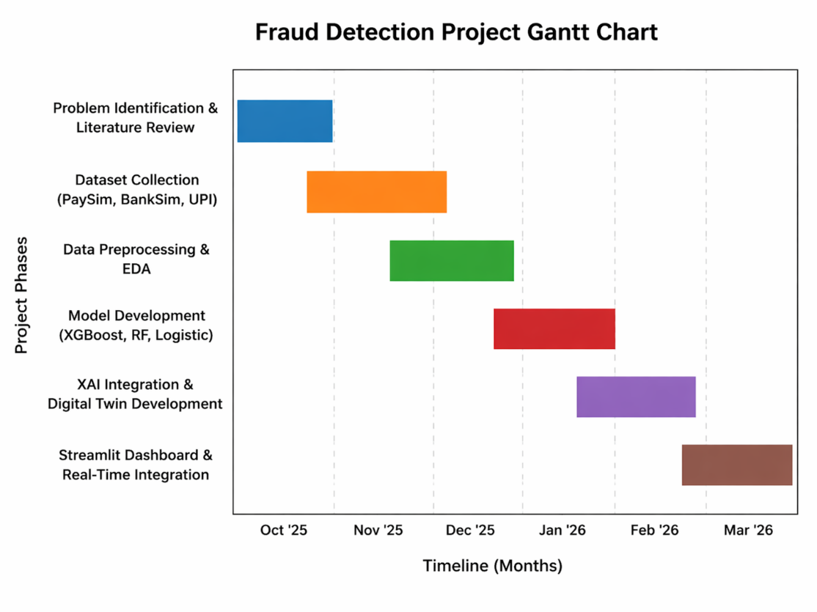
12. TIMELINE / GANTT CHART
❖ Planned vs Completed Tasks:
October: Problem Identification & Literature Review
November: Dataset Collection (PaySim, BankSim, UPI)
December: Data Preprocessing & Exploratory Data Analysis (EDA)
January (2026): Model Development (XGBoost, RF, Logistic ,)
February: XAI Integration & Digital Twin Development
March: Streamlit Dashboard & Real-Time Integration
❖ Next Milestones:
Model Optimization & Fine-tuning
Multi-Domain Performance Validation
Final Technical Report Submission
Final Viva & Review-III Presentation

Slide 26
13. REFERENCES
[1] Sharma, R., Gupta, P., & Verma, S. (2023). Transparent AI for adaptive fraud detection using explainable machine learning models. IEEE Access, 11, 45678–45690.
[2] Menon, A., Krishnan, R., & Iyer, V. (2023). AI-enabled digital twin models to enhance security in smart city environments. IEEE Internet of Things Journal, 10(8), 6789–6802.
[3] Singh, D., & Rao, K. (2024). A review of digital twins and their application in cybersecurity. Artificial Intelligence Review, 57(2), 1234–1256.
[4] Mehta, S., Jain, A., & Kulkarni, R. (2024). A comprehensive state-of-the-art review for digital twin: Cybersecurity perspectives and open challenges. Lecture Notes in Computer Science, 14012, 89–104.
[5] Gupta, R., Sharma, N., & Patel, V. (2022). Analysis and detection of fraudulence using machine learning practices with digital twin approach. Advances in Intelligent Systems and Computing, 1375, 210–220.
[6] Reddy, K., Kumar, S., & Nair, P. (2023). AI-enabled cybersecurity using synthetic data for anomaly detection. IEEE Transactions on Network Science and Engineering, 10(5), 3345–3356.
[7] Verma, P., Singh, R., & Tiwari, M. (2023). Digital twins driven by artificial intelligence to mitigate and simulate cyber threats. IEEE Access, 11, 98765–98780

Slide 27
REFERENCES (CONTD..,)
[8] Das, S., Roy, A., & Ghosh, D. (2023). Integrating digital twins with AI for real-time intrusion detection systems. IEEE Transactions on Industrial Informatics, 19(6), 4567–4578.
[9] Ramesh, K., Iyer, S., & Menon, V. (2023). A comprehensive review on cybersecurity of digital twin systems. IEEE Access, 11, 112233–112250.
[10] Kumar, A., & Singh, P. (2023). A study of predictive analytics for fraud detection using machine learning techniques. International Journal of Financial Management Research, 5(4), 45–52.
[11] Jain, R., Shah, D., & Patel, H. (2023). Machine learning-based real-time fraud detection in financial transactions. IEEE Access, 11, 22334–22345.
[12] Patel, M., Desai, K., & Joshi, A. (2023). Digital twin-based simulation for fraud risk assessment in financial systems. IEEE Transactions on Dependable and Secure Computing, 20(4), 5678–5689.
[13] Iyer, V., Krishnan, R., & Menon, A. (2023). Explainable artificial intelligence (XAI): A systematic literature review. IEEE Access, 11, 33445–33460.

Slide 28
REFERENCES (CONTD..,)
[14] Kapoor, S., Bansal, R., & Agarwal, P. (2023). Cybersecurity simulation using digital twin technology. ACM Computing Surveys, 55(7), 1–25.
[15] Mishra, S., Gupta, R., & Tiwari, P. (2023). A survey on machine learning approaches for telecom fraud detection. IEEE Communications Surveys & Tutorials, 25(3), 1456–1478.
[16] Ghosh, D., Roy, S., & Das, A. (2023). Cybersecurity threat detection in financial institutions using artificial intelligence. IEEE Access, 11, 55667–55680.
[17] Desai, K., Patel, V., & Shah, R. (2023). Impact of deep feature synthesis on deep learning in electronic fraud detection. IEEE Transactions on Big Data, 9(2), 345–356.
[18] Joshi, A., Mehta, S., & Kumar, R. (2023). Fighting insurance fraud with hybrid AI/ML models. IEEE Access, 11, 77889–77905.
[19] Agarwal, P., Singh, V., & Sharma, R. (2023). Synthetic data in cybersecurity: A comprehensive review. IEEE Access, 11, 88990–89005.
[20] Sen, T., Banerjee, A., & Roy, P. (2023). Can synthetic data protect privacy in cybersecurity systems? Computers & Security, 128, 103234.

Slide 29
Thank You

